Slide 1

Facebook Page - Analytics
OC team

Slide 2
Performance Over Time

Slide 3
Insights
Impressions & Engagements: July was your highest-performing month (959 impressions, 207 engagements).
Engagement Rate: Highest in July (approx. 3.6%), meaning content was creative and resonated strongly
Audience Growth: Positive from July onward, and then it was steady
Published Posts: July had the most posts (4), but engagement stayed strong as it has good content quality
Audience (Avg): Slowly increasing (from approx. 114 in June to 124 in Oct).
July showed the strongest overall engagement and visibility, driven by both higher posting frequency and well-performing content.
Engagement rate remained healthy (average 6%), with noticeable peaks during high-activity months.
Audience growth was steady, indicating that consistent posting and engagement contribute to follower gains.
Posting frequency (4 posts in July) appears correlated with better impressions and interactions

Slide 4
Net Audience Growth

Slide 5
Insights
Audience grew most in August and September (+4 each)
Lower growth in July (+1) despite high engagement, meaning visibility didn’t always convert to followers
Zero growth in June, but activity likely began increasing afterward
Strongest follower growth occurred in August–September, likely reflecting higher content quality
The correlation between engagement and audience growth indicates that audience retention and attraction are linked to content interaction

Slide 6
Engagement Rate vs Net Audience Growth

Slide 7
Insights
July had the highest engagement (3.6%) but minimal audience growth (+1), suggesting content resonated with existing followers but didn’t reach many new users – Engagement Peaks don’t always assure equal follower growth
Despite lower engagement rates, August (+4) and September (+4) saw the highest follower gains, likely from improved reach or campaigns that drew new audiences
From August onward, both engagement and audience growth stabilized, showing improved visibility and consistent audience interest
We need to focus on other strategies, such as interactive visuals to attract more followers

Slide 8
Visibility vs Interaction trend

Slide 9
Posting Frequency vs Engagement
Engagement rate rises during months (July & September) with higher posting frequency, suggesting consistent content output drives stronger audience response

Slide 10
EnGAGEMENT TYPE

Slide 11
Insights
July had the highest engagement depth — 76 reactions, 15 comments, 3 shares.
Clicks (especially “Other Post Clicks”) peaked in July and September, good call-to-action strength
Shares are low overall (5 total), meaning posts are being viewed but not widely redistributed
Most engagement is reaction-based (approx. 70%), showing strong visibility but limited community distribution (due to low shares)
July’s high comment volume suggests that the content in July performed well
Click-based actions (links or post interactions) remain limited, so there’s room to modify or improve our content to increase CTA

Slide 12
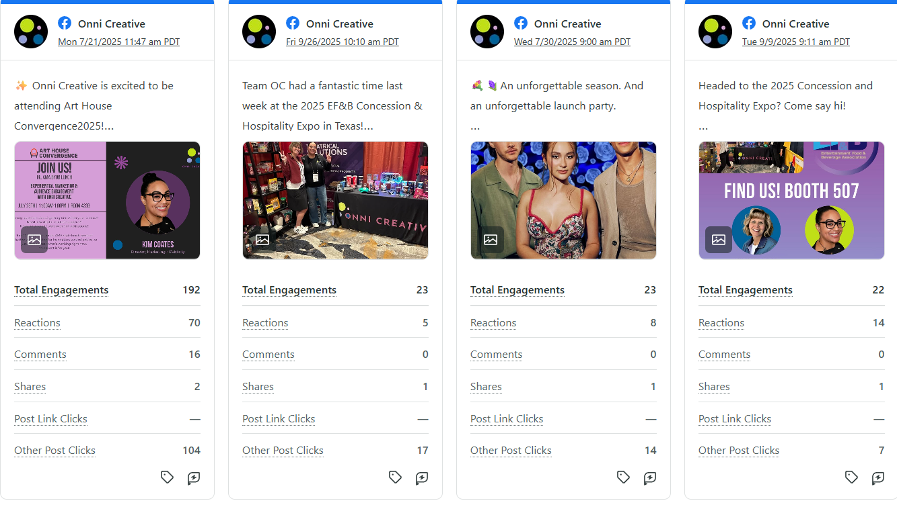
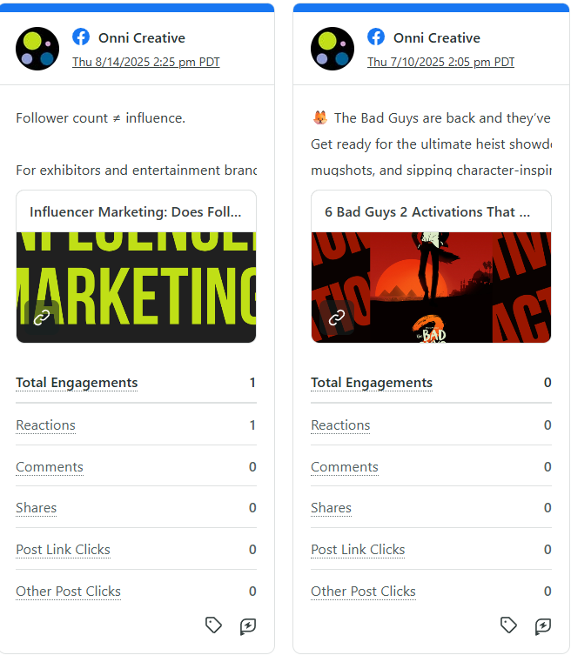
FACEBOOK POSTS

Slide 13
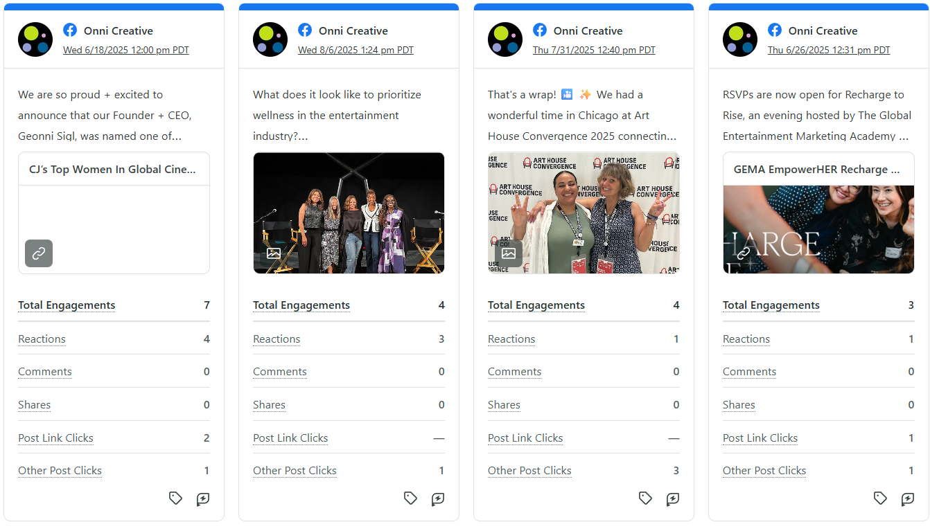

Slide 14
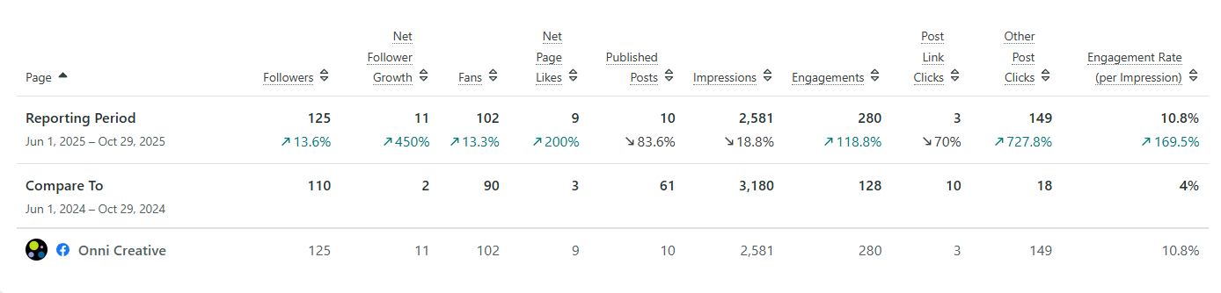
COMPARE TO JUNE 2024 – OCT 2024

